Slide 1
Transportation, Assignment and Transshipment Problems

Slide 2
Change 2: Changing the objective function coefficient of a BV
Because we are changing c_{BV}B⁻¹, the coefficient of each nonbasic variable in row 0 may change, and to determine whether the current basis remains optimal, we must find the new ui’s and vj’s and use these values to price out all nonbasic variables.
The current basis remains optimal as long as all nonbasic variables price out nonpositive.

Slide 3
Change 3: Increasing both supply and Demand by ∆
Observe that this change maintains a balanced transportation problem.
Because the ui’s and vj’s may be thought of as the negative of each constraint’s shadow prices,
we know that if the current basis remains optimal,

Slide 4
We may also find the new values of the decision variables as follows:
1) If xij is a basic variable in the optimal solution, then increase xij by ∆ .
2) If xij is a nonbasic variable in the optimal solution, then find the loop involving xij and some of the basic variables.
Find an odd cell in the loop that is in row i. Increase the value of this odd cell by ∆ and go around the loop, alternately increasing and then decreasing current basic variables in the loop by ∆ .

Slide 5
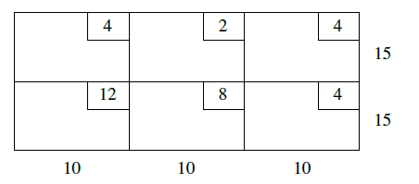
Example
Consider the balanced transportaton problem given in table.
a) Find the optimal solution (Use Northwest Corner as the initial bfs)
b) For what values of c12 and c21 The current basis remain optimal?
c) if s1 and d1 is increased by 2 units what will be the new optimal solution?
d) if s1 And d3 is increased by 1 units what will be the new optimal solution)

Slide 6
Assignment Problems
Machineco has four machines and four jobs to be completed.
Each machine must be assigned to complete one job. The time required to set up each machine for completing each job is shown in Table.
Machineco wants to minimize the total setup time needed to complete the four jobs.
Use linear programming to solve this problem.

Slide 7
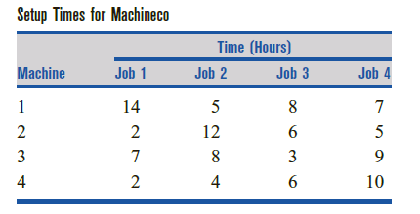

Slide 8
Ignoring for the moment the xij= 0 or xij = 1 restrictions, we see that Machineco faces a balanced transportation problem in which each supply point has a supply of 1 and each demand point has a demand of 1.
In general, an assignment problem is a balanced transportation problem in which all supplies and demands are equal to 1.
Thus, an assignment problem is characterized by knowledge of the cost of assigning each supply point to each demand point.
The assignment problem’s matrix of costs is its cost matrix.
Because the right-hand side of each constraint is equal to 1, each xij must be a nonnegative integer that is no larger than 1, so each xij must equal 0 or 1.
This means that we can ignore the restrictions that xij 0 or 1

Slide 9
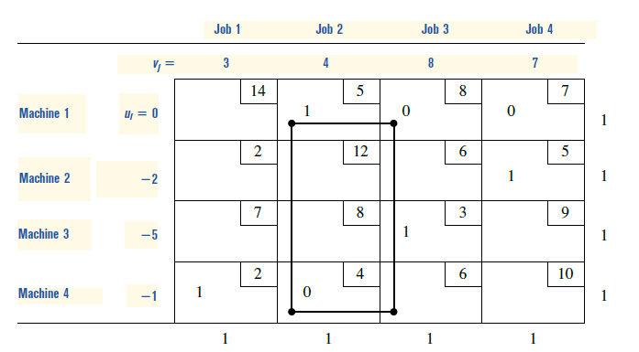

Slide 10
Hungarian Method
Looking back at our initial bfs, we see that it was an optimal solution.
We did not know that it was optimal, however, until performing one iteration of the transportation simplex.
This suggests that the high degree of degeneracy in an assignment problem may cause the transportation simplex to be an inefficient way of solving assignment problems.
For this reason (and the fact that the algorithm is even simpler than the transportation simplex), the Hungarian method is usually used to solve assignment (min) problems:

Slide 11
Step 1 Find the minimum element in each row of the m X m cost matrix. Construct a new matrix by subtracting from each cost the minimum cost in its row. For this new matrix, find the minimum cost in each column. Construct a new matrix (called the reduced cost matrix) by subtracting from each cost the minimum cost in its column.
Step 2 Draw the minimum number of lines (horizontal, vertical, or both) that are needed to cover all the zeros in the reduced cost matrix. If m lines are required, then an optimal solution is available among the covered zeros in the matrix. If fewer than m lines are needed, then proceed to step 3.
Step 3 Find the smallest nonzero element (call its value k) in the reduced cost matrix that is uncovered by the lines drawn in step 2. Now subtract k from each uncovered element of the reduced cost matrix and add k to each element that is covered by two lines. Return to step 2.

Slide 12
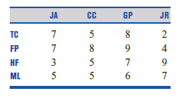
Example
Tom Cruise, Freddy Prinze Jr., Harrison Ford, and Matt LeBlanc are marooned on a desert island with Jennifer Aniston, Courteney Cox, Gwynet Paltrow, and Julia Roberts. The “compatibility measures” in Table indicate how much happiness each couple would experience if they spent all their time together. The happiness earned by a couple is proportional to the fraction of time they spend together. For example, if Freddie and Gwyneth spend half their time together, they earn happiness of ½*(9)=4,5
a Let xij be the fraction of time that the ith man spends with the jth woman. The goal of the eight people is to maximize the total happiness of the people on the island. Formulate an LP whose optimal solution will yield the optimal values of the xij’s.
b Explain why the optimal solution in part (a) will have four xij = 1 and twelve xij = 0. The optimal solution requires that each person spend all his or her time with one person of the opposite sex, so this result is often referred to as the Marriage Theorem.
c Determine the marriage partner for each person.

Slide 13
Transshipment Problems
A transportation problem allows only shipments that go directly from a supply point to a demand point.
In many situations, shipments are allowed between supply points or between demand points.
These points are called transshipment points
Shipping problems with any or all of these characteristics are transshipment problems.
Fortunately, the optimal solution to a transshipment problem can be found by solving a transportation problem.

Slide 14
We define a supply point to be a point that can send goods to another point but cannot receive goods from any other point.
Similarly, a demand point is a point that can receive goods from other points but cannot send goods to any other point.
A transshipment point is a point that can both receive goods from other points and send goods to other points.
The following example illustrates these definitions (“—” indicates that a shipment is impossible).

Slide 15
Widgetco manufactures widgets at two factories, one in Memphis and one in Denver.
The Memphis factory can produce as many as 150 widgets per day, and the Denver factory can produce as many as 200 widgets per day.
Widgets are shipped by air to customers in Los Angeles and Boston. The customers in each city require 130 widgets per day.
Because of the deregulation of airfares, Widgetco believes that it may be cheaper to first fly some widgets to New York or Chicago and then fly them to their final destinations.
The costs of flying a widget are shown in Table.
Widgetco wants to minimize the total cost of shipping the required widgets to its customers.

Slide 16
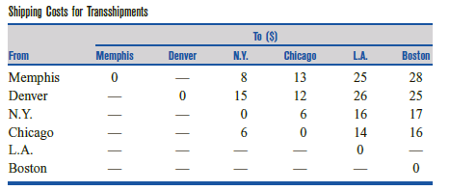

Slide 17
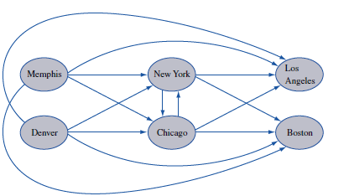
Demand points: Memphis, Denver
Supply Points:Los Angelos, Boston
Transhipment Points: New York, Chicago

Slide 18
We now describe how the optimal solution to transshipment problem can be found by solving a transportation problem.
Given a transshipment problem, create a balanced transportation problem by the following procedure (assume that total supply exceeds total demand):
Step 1 If necessary, add a dummy demand point (with a supply of 0 and a demand equal to the problem’s excess supply) to balance the problem. Shipments to the dummy and from a point to itself will, of course, have a zero shipping cost. Let s = total available supply.

Slide 19
Step 2 Construct a transportation tableau as follows: A row in the tableau will be needed for each supply point and transshipment point, and a column will be needed for each demand point and transshipment point. Each supply point will have a supply equal to its original supply, and each demand point will have a demand equal to its original demand.
Let s = total available supply. Then each transshipment point will have a supply equal to (point’s original supply) + s and a demand equal to (point’s original demand) + s. This ensures that any transshipment point that is a net supplier will have a net outflow equal to the point’s original supply, and, similarly, a net demander will have a net inflow equal to the point’s original demand. Although we don’t know how much will be shipped through each transshipment point, we can be sure that the total amount will not exceed s.
This explains why we add s to the supply and demand at each transshipment point. By adding the same amounts to the supply and demand, we ensure that the net outflow at each transshipment point will be correct, and we also maintain a balanced transportation tableau.

Slide 20
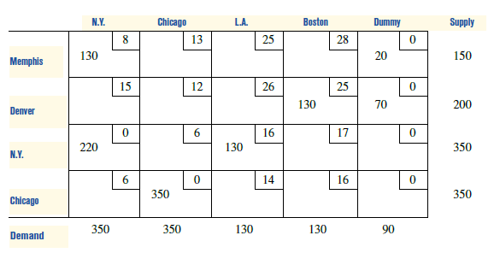
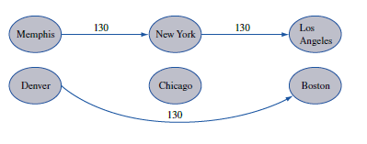

Slide 21
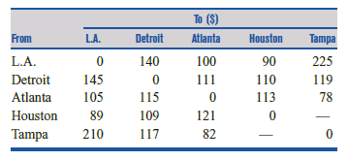
Example
General Ford produces cars at L.A. and Detroit and has a warehouse in Atlanta; the company supplies cars to customers in Houston and Tampa.
The cost of shipping a car between points is given in Table (“—” means that a shipment is not allowed).
L.A. can produce as many as 1,100 cars, and Detroit can produce as many as 2,900 cars.
Houston must receive 2,400 cars, and Tampa must receive 1,500 cars.
a Formulate a balanced transportation problem that can be used to minimize the shipping costs incurred in meeting demands at Houston and Tampa.
b Modify the answer to part (a) if shipments between L.A. and Detroit are not allowed.
c Modify the answer to part (a) if shipments between Houston and Tampa are allowed at a cost of $5.

Slide 22
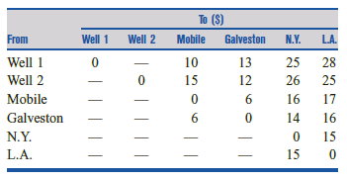
Example
Sunco Oil produces oil at two wells. Well 1 can produce as many as 150,000 barrels per day, and well 2 can produce as many as 200,000 barrels per day.
It is possible to ship oil directly from the wells to Sunco’s customers in Los Angeles and New York. Alternatively, Sunco could transport oil to the ports of Mobile and Galveston and then ship it by tanker to New York or Los Angeles.
Los Angeles requires 160,000 barrels per day, and New York requires 140,000 barrels per day.
The costs of shipping 1,000 barrels between two points are shown in. Formulate a transshipment model (and equivalent transportation model) that could be used to minimize the transport costs in meeting the oil demands of Los Angeles and New York.

